Slide 1
Randomized Algorithms CS648
Lecture 13
Approximate Distance Oracles
Chebyshev’s Inequality with applications

Slide 2
Approximate Distance oracles

Slide 3
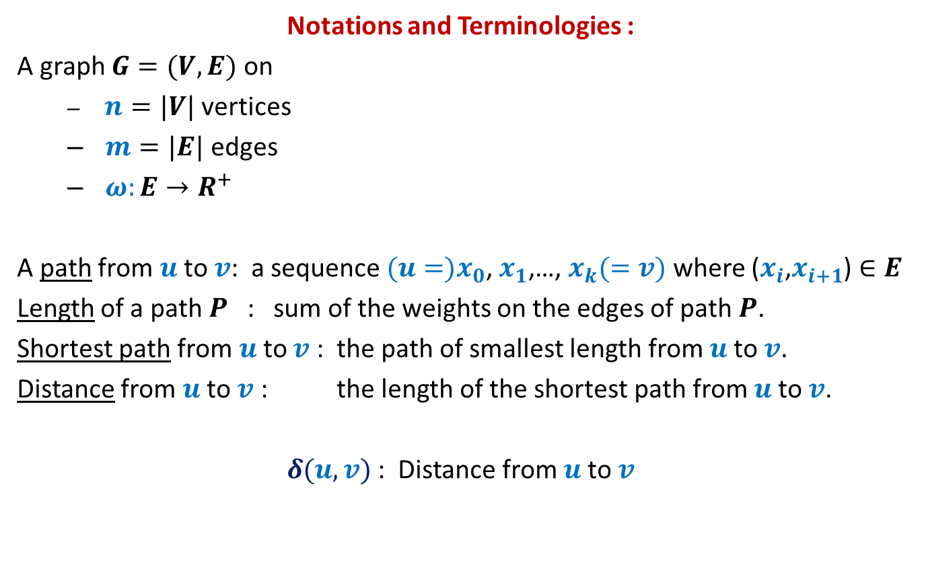
All-Pairs Shortest Paths
Notations and Terminologies :
A graph $G=(V,E)$ on
$n=|V|$ vertices
$m=|E|$ edges
$ω:E→R^{+}$
A path from $u$to $v$: a sequence ${(u=)x}_{0}$, $x_{1}$,…, $x_{k}(=v)$ where ($x_{i}$,$x_{i+1}$) $∈E$
Length of a path $P$ : sum of the weights on the edges of path $P$.
Shortest path from $u$to $v$ : the path of smallest length from $u$to $v$.
Distance from $u$to $v$ : the length of the shortest path from $u$to $v$.
$δ(u,v)$ : Distance from $u$to $v$

Slide 4
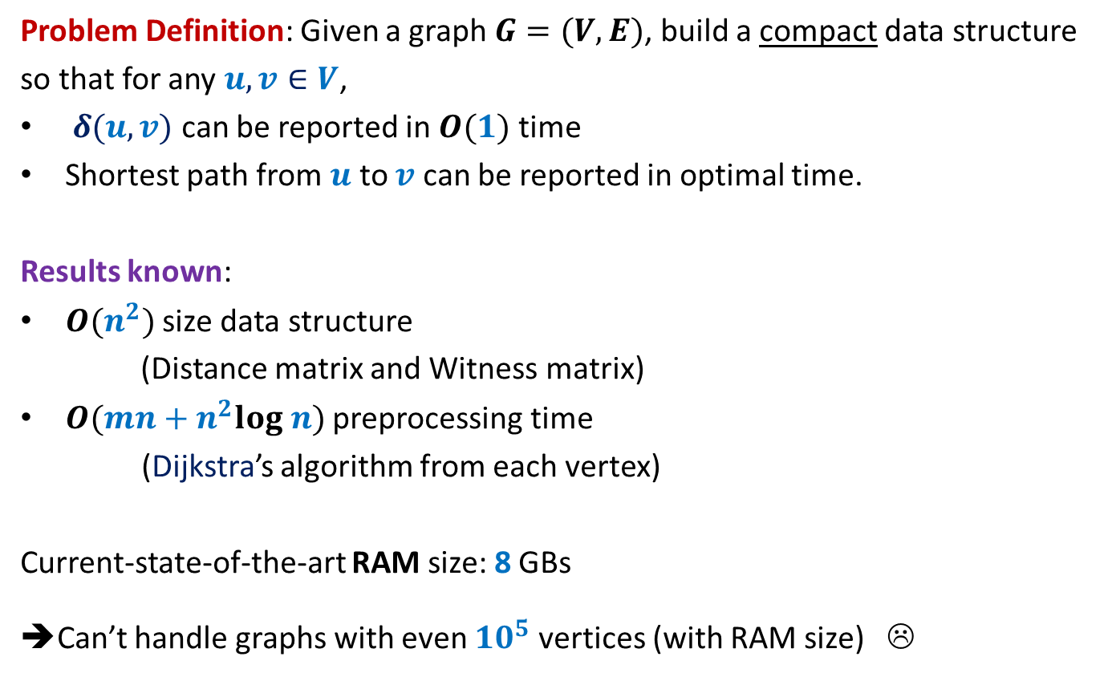
All-Pairs Shortest Paths
Problem Definition: Given a graph $G=(V,E)$, build a compact data structure
so that for any $u,v∈V$,
$δ(u,v)$ can be reported in $O(1)$ time
Shortest path from $u$ to $v$ can be reported in optimal time.
Results known:
$O(n^{2})$ size data structure
(Distance matrix and Witness matrix)
$O(mn+n^{2}log n)$ preprocessing time
(Dijkstra’s algorithm from each vertex)
Current-state-of-the-art RAM size: 8 GBs
➔Can’t handle graphs with even ${10}^{5}$ vertices (with RAM size) ☹

Slide 5
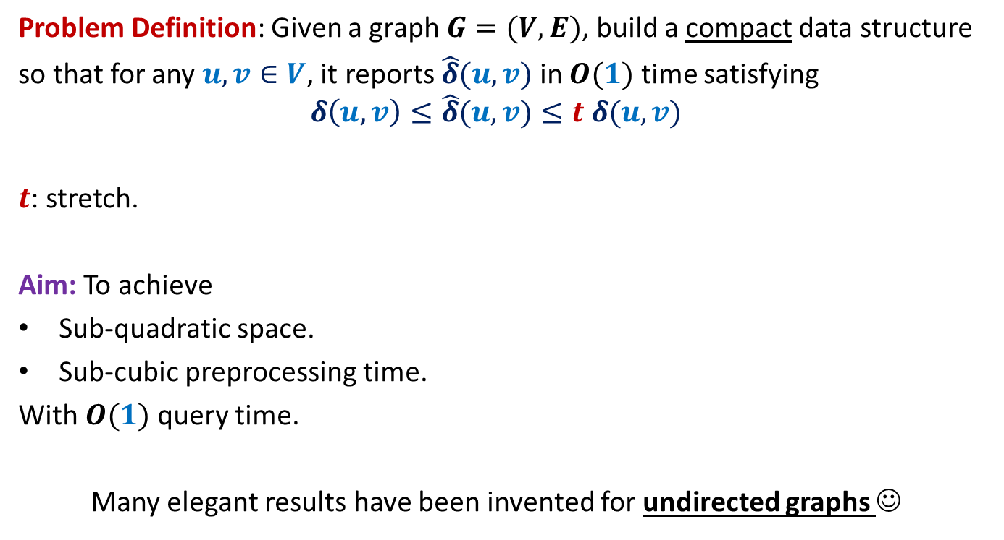
All-Pairs Approximate Shortest Paths
Problem Definition: Given a graph $G=(V,E)$, build a compact data structure
so that for any $u,v∈V$, it reports $\hat{δ}(u,v)$ in $O(1)$ time satisfying
$$δ\left(u,v\right)≤\hat{δ}(u,v)≤t δ(u,v)$$
$t$: stretch.
Aim: To achieve
Sub-quadratic space.
Sub-cubic preprocessing time.
With $O(1)$ query time.
Many elegant results have been invented for undirected graphs ☺

Slide 6





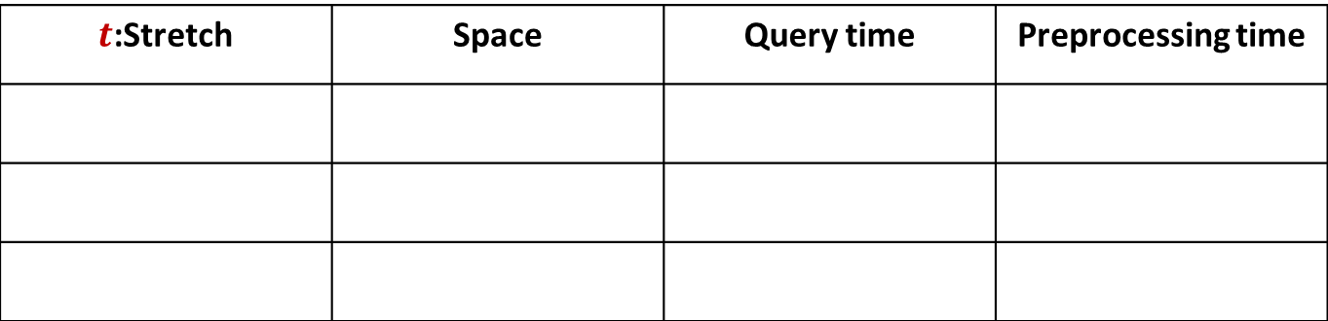







A truly magical result
Approximate Distance Oracles
$t$:Stretch | Space | Query time | Preprocessing time
$$3$$
$$O(n^{1+\frac{1}{2}})$$
$$O(1)$$
$$O({mn}^{\frac{1}{2}})$$
$$5$$
$$O(n^{1+\frac{1}{3}})$$
$$O(1)$$
$$O({mn}^{\frac{1}{3}})$$
$$2k−1$$
$$O(n^{1+\frac{1}{k}})$$
$$O(k)$$
$$O({k mn}^{\frac{1}{k}})$$
Mikkel Thorup and Uri Zwick:
Approximate Distance Oracles for graphs,
Journal of ACM (4), 2005

Slide 7
Inspiration from our daily life

Slide 8




Air/Road Network
$$Lucknow$$
$$Delhi$$
$$Kanpur$$
$$Bangalore$$

Slide 9

The Idea
Given a graph $G=(V,E)$,
Compute a small set $L$ of Landmark vertices.
From each vertex $u∈V\backslash L$, store distance to vertices present in its locality.
From each vertex $v∈L$, store distance to all vertices in the graph.
Questions:
What is the formal notion of locality ?
How to retrieve distance from $u$ to a far away vertex ?
What is the guarantee of stretch ?
How to compute the desired set $L$ efficiently ?

Slide 10

Formal notion of locality
$$u$$

Slide 11



Formal notion of locality
$Ball(u,V,L)$= {$x∈V| δ\left(u,x\right)<δ\left(u,L(u)\right)$}
$$L(u)$$
$$u$$
$$Ball(u,V,L)$$

Slide 12





Reporting distance from $u$
Report $δ\left(u,L(u)\right)+δ\left(L(u),v\right)$
$$δ\left(u,L(u)\right)≤δ\left(u,v\right)$$
$$v$$
$$v$$
$$L(u)$$
$$u$$
$$Ball(u,V,L)$$

Slide 13



What is the stretch ?
stretch $≤3$
$$δ\left(u,L(u)\right)≤δ\left(u,v\right)$$
??
$$≤δ\left(u,v\right)+δ\left(u,L(u)\right)$$
$≤2δ\left(u,v\right)$
$$v$$
$$L(u)$$
$$u$$
$$Ball(u,V,L)$$

Slide 14
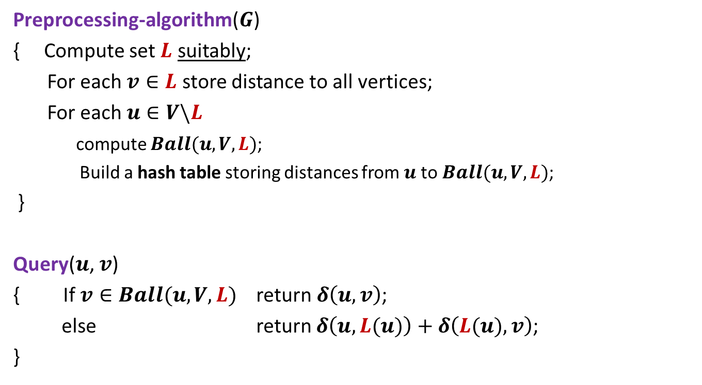
3-approximate distance oracle
Preprocessing-algorithm($G$)
{ Compute set $L$ suitably;
For each $v∈L$ store distance to all vertices;
For each $u∈V\backslash L$
compute $Ball(u,V,L)$;
Build a hash table storing distances from $u$to $Ball(u,V,L)$;
}
Query($u$, $v$)
{ If $v∈Ball(u,V,L)$ return $δ\left(u,v\right)$;
else return $δ\left(u,L(u)\right)+δ\left(L(u),v\right)$;
}
Global distance info.
Local distance info.

Slide 15
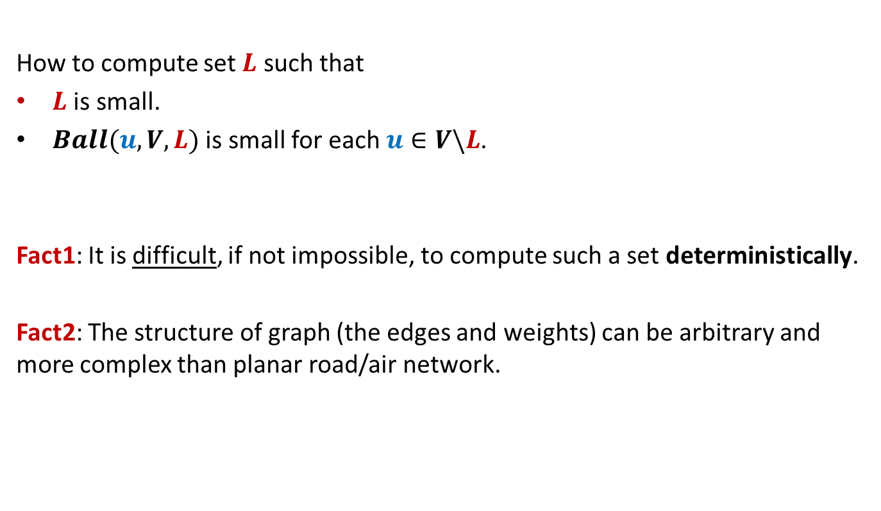
The real challenge left
How to compute set $L$ such that
$L$ is small.
$Ball(u,V,L)$ is small for each $u∈V\backslash L$.
Fact1: It is difficult, if not impossible, to compute such a set deterministically.
Fact2: The structure of graph (the edges and weights) can be arbitrary and more complex than planar road/air network.

Slide 16
The real challenge left
$$L(u)$$
$$u$$
$$Ball(u,V,L)$$

Slide 17
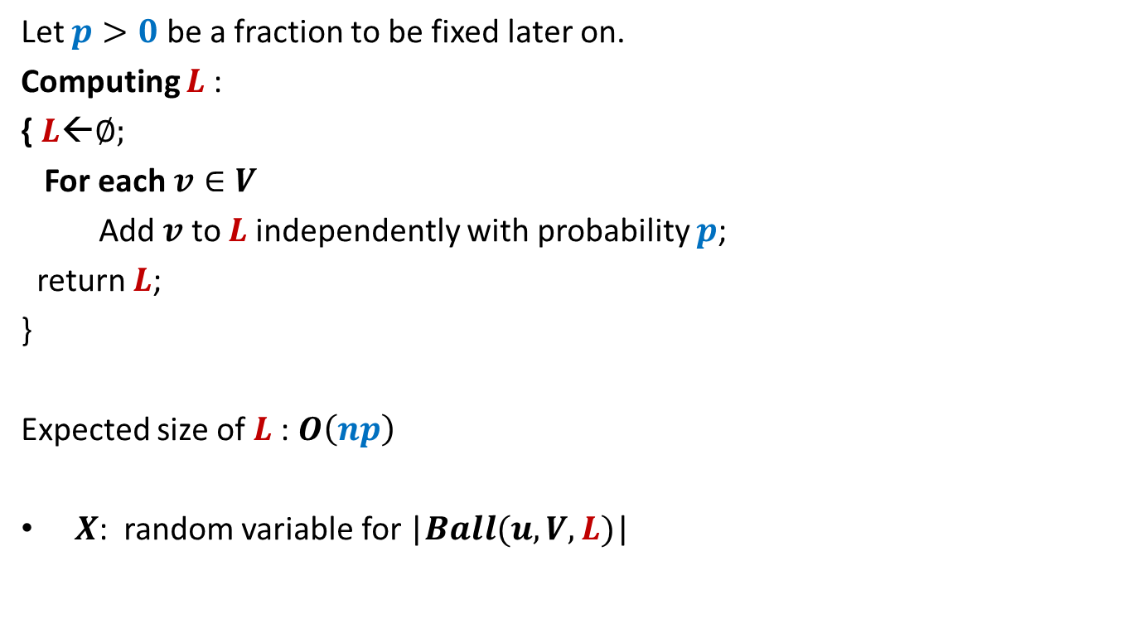
Conquering the challenge
Let $p>0$ be a fraction to be fixed later on.
Computing $L$:
{ $L$←∅;
For each $v∈V$
Add $v$ to $L$independently with probability $p$;
return $L$;
}
Expected size of $L$: $O\left(np\right)$
$X$: random variable for |$Ball(u,V,L)$|

Slide 18

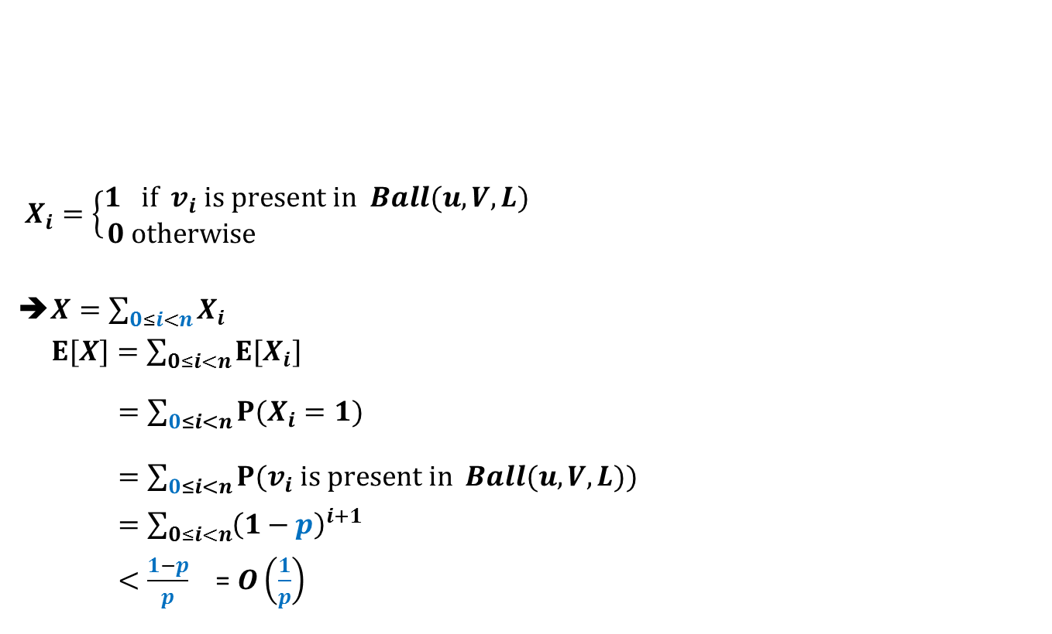
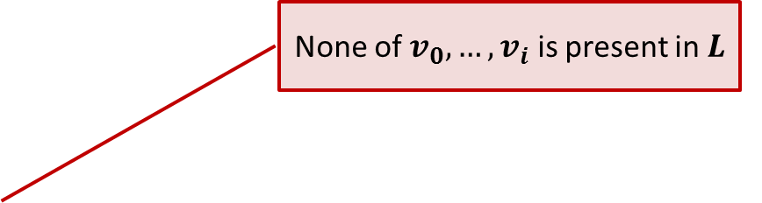



Expected size of $Ball(u,V,L)$
$$Ball(u,V,L)$$
$X_{i}=\left\{\begin{aligned}1 if v_{i} is present in Ball(u,V,L) \\ 0 otherwise \end{aligned}\right.$
➔$X=\sum_{0≤i<n}{X_{i}}$
$E[X]=\sum_{0≤i<n}{E[X_{i}]}$
$=\sum_{0≤i<n}{P(X_{i}=1)}$
$=\sum_{0≤i<n}{P(v_{i} is present in Ball(u,V,L))}$
$=\sum_{0≤i<n}{{\left(1−p\right)}^{i+1}}$
$<\frac{1−p}{p}$ = $O\left(\frac{1}{p}\right)$
$$u$$
$v_{1} v_{2}$ … $v_{i}$ … $v_{n−1}$
Increasing order of distance from $u$
None of $v_{0}, …,v_{i}$ is present in $L$

Slide 19

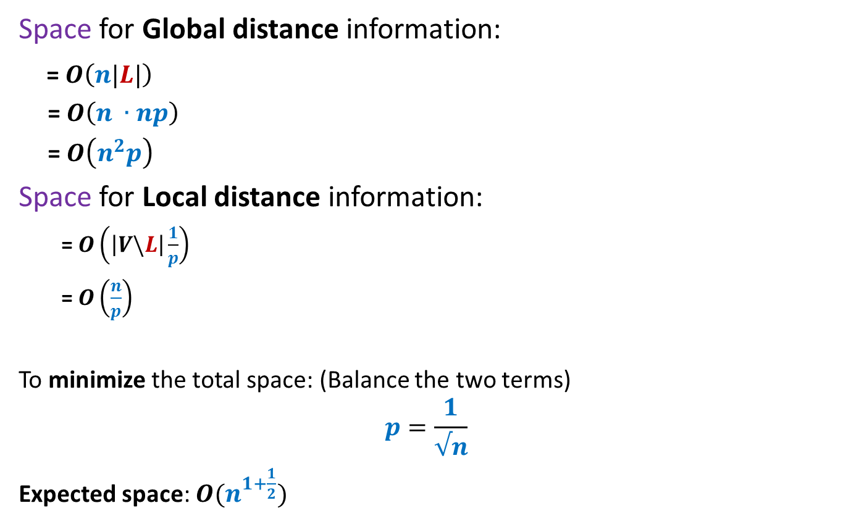
Expected space of 3-approximate distance oracle
Space for Global distance information:
= $O\left(n|L|\right)$
= $O\left(n ∙np\right)$
= $O\left(n^{2}p\right)$
Space for Local distance information:
= $O\left(\left|V\backslash L\right|\frac{1}{p}\right)$
= $O\left(\frac{n}{p}\right)$
To minimize the total space: (Balance the two terms)
$$p=\frac{1}{√n}$$
Expected space: $O(n^{1+\frac{1}{2}})$
Each vertex in $V\backslash L$ keeps a Ball)

Slide 20
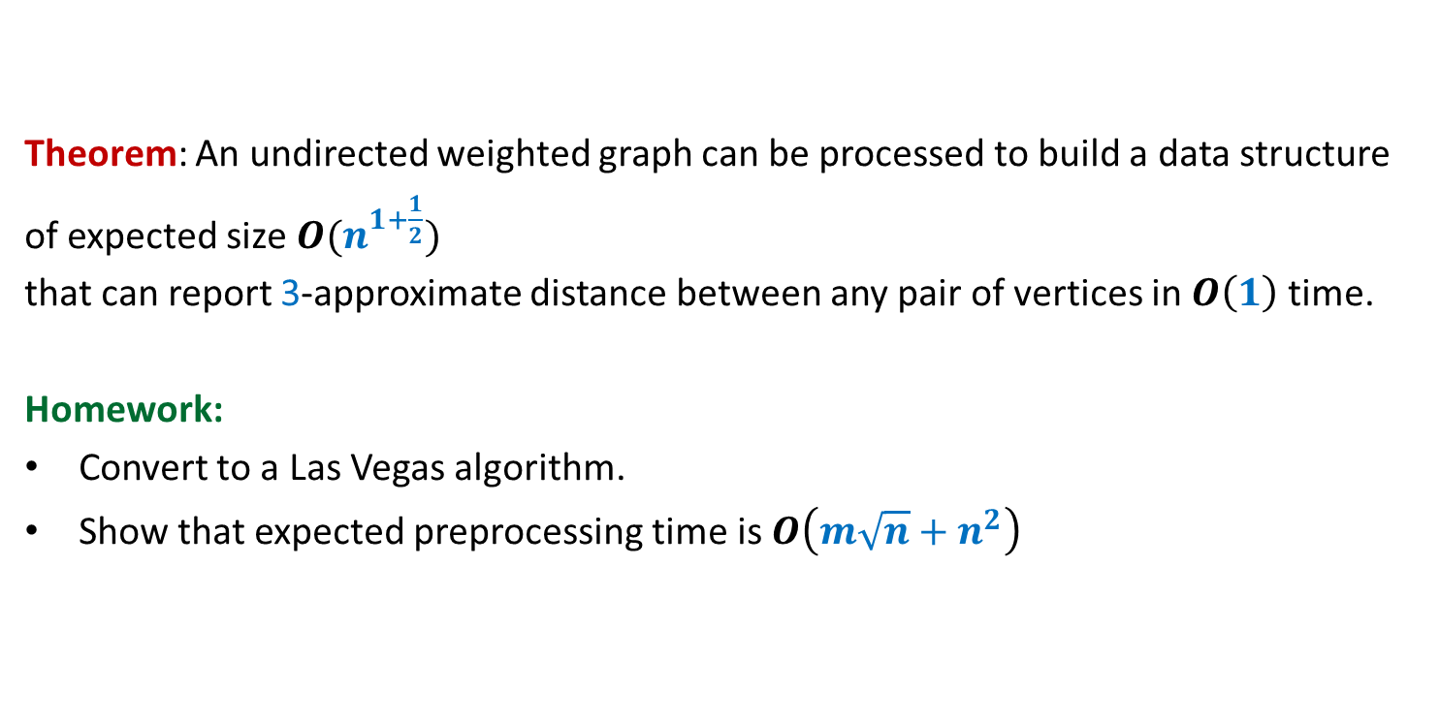
Theorem: An undirected weighted graph can be processed to build a data structure
of expected size $O(n^{1+\frac{1}{2}})$
that can report 3-approximate distance between any pair of vertices in $O\left(1\right)$ time.
Homework:
Convert to a Las Vegas algorithm.
Show that expected preprocessing time is $O\left(m\sqrt{n}+n^{2}\right)$

Slide 21
5-approximate distance oracle
?

Slide 22
5-approximate distance oracle
Meant for only those (hopefully nonzero no. of) students whose aim is more than just a good grade in this course.
Watch the next 3 slides only after you have tried really hard …

Slide 23


3-approximate distance oracle
$$L$$
$$V$$

Slide 24


5-approximate distance oracle
$$L_{2}$$
$$L_{1}$$
$$V$$

Slide 25




5-approximate distance oracle
$$L_{2}(u)$$
$$L_{1}(u)$$
$$u$$
$$Ball(u,V,L_{1})$$
$$Ball(u,L_{1}, L_{2})$$

Slide 26
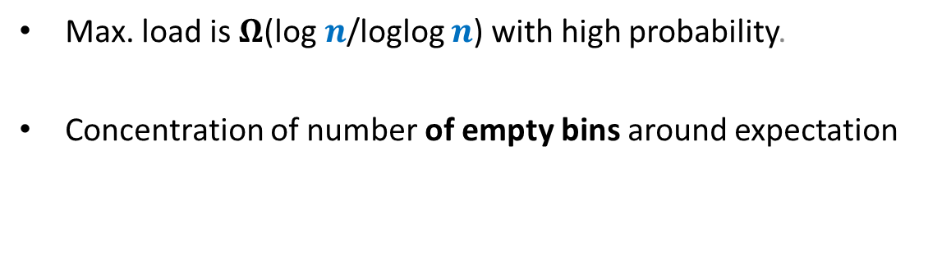
Chebyshev’s Inequality
Max. load is $Ω$(log $n$/loglog $n$) with high probability.
Concentration of number of empty bins around expectation

Slide 27
A central question in Probability
P[$X>$E[$X$] $+ δ$ ] = ?
P[$X<$E[$X$] $− δ$ ] = ?

Slide 28
Tools studied till now
Markov Inequality
Chernoff bound
Limitations
Only for positive r.v. $X$
Gives very loose bound.
One sided only
(Not applicable for P[$X<$ E[$X$] $− δ$ ])
Limitations
Too restrictive ☹
$X$ has to be
Sum of 0-1 random variables $X_{i}$’s.
Independence among $X_{i}$’s

Slide 29
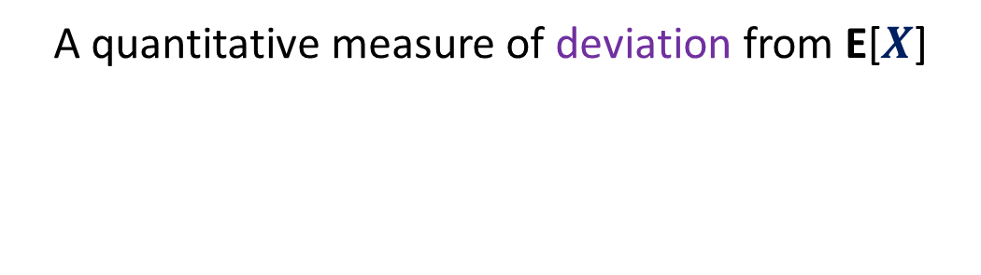
Variance
A quantitative measure of deviation from E[$X$]

Slide 30




What is P[$X>a]$
$X$ : a random variable defined over a probability space ($Ω$,P).
$$X$$
Probability
$$a$$
E[$X$]
Discrete values

Slide 31








$X$ : a random variable defined over a probability space ($Ω$,P).
$Y$ : a random variable defined over the same probability space.
E[$X$] = E[$Y$]
$$a$$
$$a$$
P[$Y>a]$
P[$X>a]$
$$Y$$
$$X$$
Probability
Probability
E[$X$]
E[$Y$]
Discrete values
Discrete values
Discrete values

Slide 32



$X$ : a random variable defined over a probability space ($Ω$,P).
$Y$ : a random variable defined over the same probability space.
E[$X$] = E[$Y$]
P[$X<a]$
P[$Y<a]$
$$a$$
$$a$$
$$Y$$
$$X$$
Probability
Probability
E[$X$]
E[$Y$]
Discrete values
Discrete values
Discrete values

Slide 33
Let us combine the deviations on both sides.

Slide 34


Which r.v. has more deviation from expected value?
$X$ : a random variable defined over a probability space ($Ω$,P).
$Y$ : a random variable defined over the same probability space.
P[$|X−E\left[X\right]|>δ]$ = ?
P[$|Y−E\left[Y\right]|>δ]$ = ?
E[$X$] = E[$Y$]
$$δ$$
$$δ$$
$$δ$$
$$δ$$
$$Y$$
$$X$$
$$Y$$
Probability
Probability
With insights from this example, try to quantify the deviation
of a random variable.
E[$X$]
E[$Y$]
Discrete values
Discrete values
Discrete values

Slide 35
$$\sum_{a∈X}{(a −}\text{E}\text{[}X\text{]})⋅\text{P}\text{[}X=a\text{]}$$
Idea $2$:
We need to consider ‘distance’ of $a$from E[$X$].
Idea $1$:
We need to consider each value $a$taken by $X$ while calculating deviation.
E[$X$]
$$X$$
Probability
Farther the value $a$ from E[$X$],
more should be its contribution to deviation.
Discrete values taken by the random variables

Slide 36
$$\sum_{a∈X}{(a −}\text{E}\text{[}X\text{]})⋅\text{P}\text{[}X=a\text{]}$$
We call it
Variance of $X$
Idea $3$:
We need to consider $\text{P}\text{[}X=a\text{]}$ as well
E[$X$]
$$X$$
Probability
Larger the probability of $X$ = $a$,
more should be its contribution to deviation.
Discrete values taken by the random variables

Slide 37
Variance of $X$
$$\sum_{a∈X}{|a −}\text{E}\text{[}X\text{]}\text{|}⋅\text{P}\text{[}X=a\text{]}$$
$$=\text{E}\text{[}|X −\text{E}\text{[}X\text{]}\text{|}\text{]}$$
➔
$$\sum_{a∈X}{(a −}\text{E}\text{[}X\text{]})⋅\text{P}\text{[}X=a\text{]}$$
$$=\text{E}\text{[}{(X −\text{E}\text{[}X\text{]})}^{2}\text{]}$$
Since it is but cumbersome to deal with mod
$$2$$

Slide 38
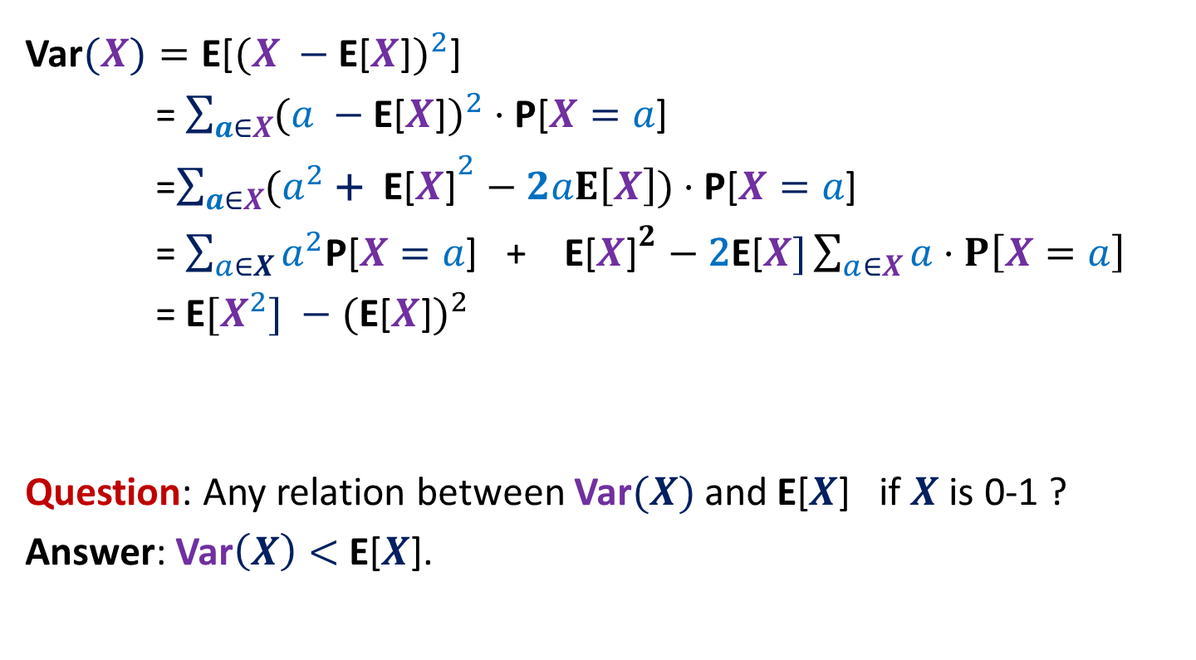

Variance of $X$
Var$(X)=\text{E}\text{[}{(X −\text{E}\text{[}X\text{]})}^{2}\text{]}$
= $\sum_{a∈X}{({a −\text{E}\text{[}X\text{]})}^{2}}⋅\text{P}\text{[}X=a\text{]}$
=$\sum_{a∈X}{({a^{2} \text{+ }\text{E}\text{[}X\text{]}}^{2}−2aE\left[X\right])}⋅\text{P}\text{[}X=a\text{]}$
= $\sum_{a∈X}{a^{2}\text{P}\text{[}X=a\text{]}\text{ + }\text{E}\text{[}X{\text{]}}^{2}−\text{2}\text{E}\text{[}X]\sum_{a∈X}{a⋅P\left[X=a\right]}}$
= $\text{E}[{X^{2}] −\text{(}\text{E}\text{[}X\text{]})}^{2}$
Question: Any relation between Var$(X)$ and $\text{E}\text{[}X$] if $X$ is 0-1 ?
Answer: Var$\left(X\right)<$ $\text{E}\text{[}X$].

Slide 39
Chebyshev’s Inequality
P[$|X−$E[$X$]| $>δ$]
= P[${\left(X −\text{E}\text{[}X\text{]}\right)}^{2}≥δ^{2}$ ]
Using Markov Inequality,
$$≤\frac{\text{E}\text{[}{(X −\text{E}\text{[}X\text{]})}^{2}\text{] }}{δ^{2}}$$
$$=\frac{\text{E}{[X^{2}] −\text{(}\text{E}\text{[}X\text{]})}^{2}\text{] }}{δ^{2}}$$
$$=\frac{\text{Var}\text{(}X\text{)} }{δ^{2}}$$
$$=\frac{(σ\text{(}X{\text{)}\text{)}}^{2} }{δ^{2}}$$
$σ$: standard deviation of $X$.

